Slide 1
SURREALISM, FREUD AND THE WORLD OF DREAMS
Digital Design for the Web

Slide 2
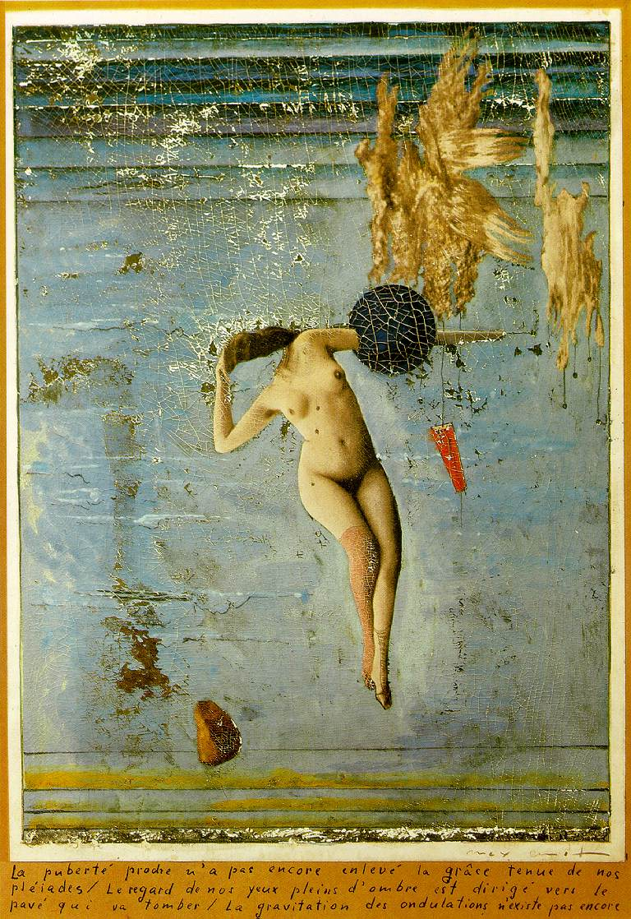
Surrealism
The practice of producing fantastic imagery or effects in art, literature, film, or theater by means of unnatural or irrational juxtapositions and combinations.
Approaching Puberty (1921) Max Ernst
Mixed Media

Slide 3
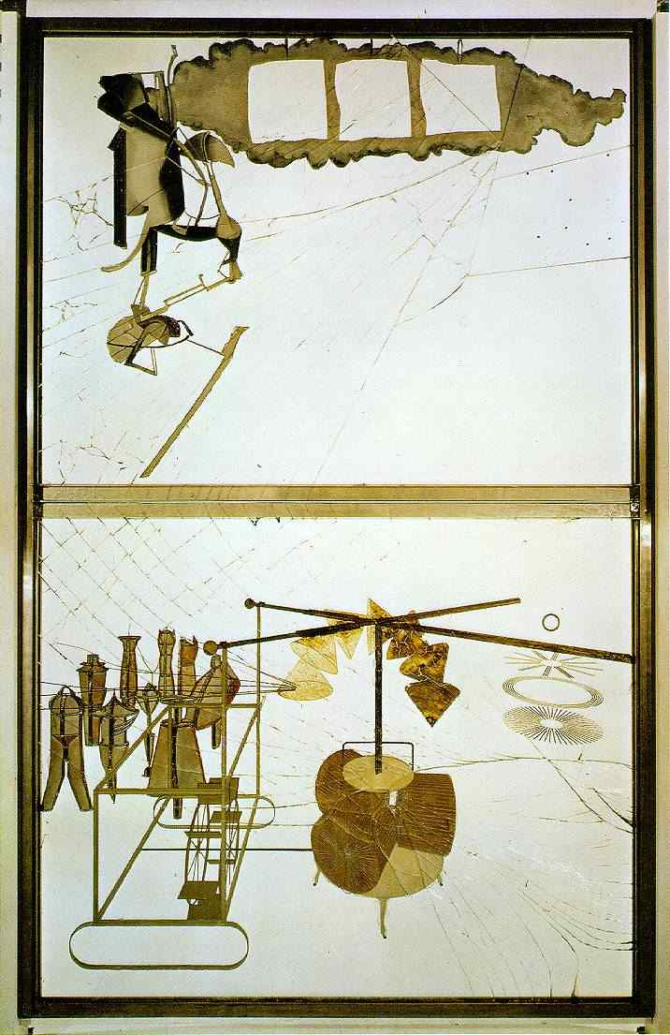
The Bride Stripped Bare by Her Bachelors, Even (1915-1923) Marcel Duchamp
Mixed Media
Dada
Dadaism was seen as a protest against the bourgeois nationalist, as well as colonialist interests which were believed to be the root of the first world war.

Slide 4
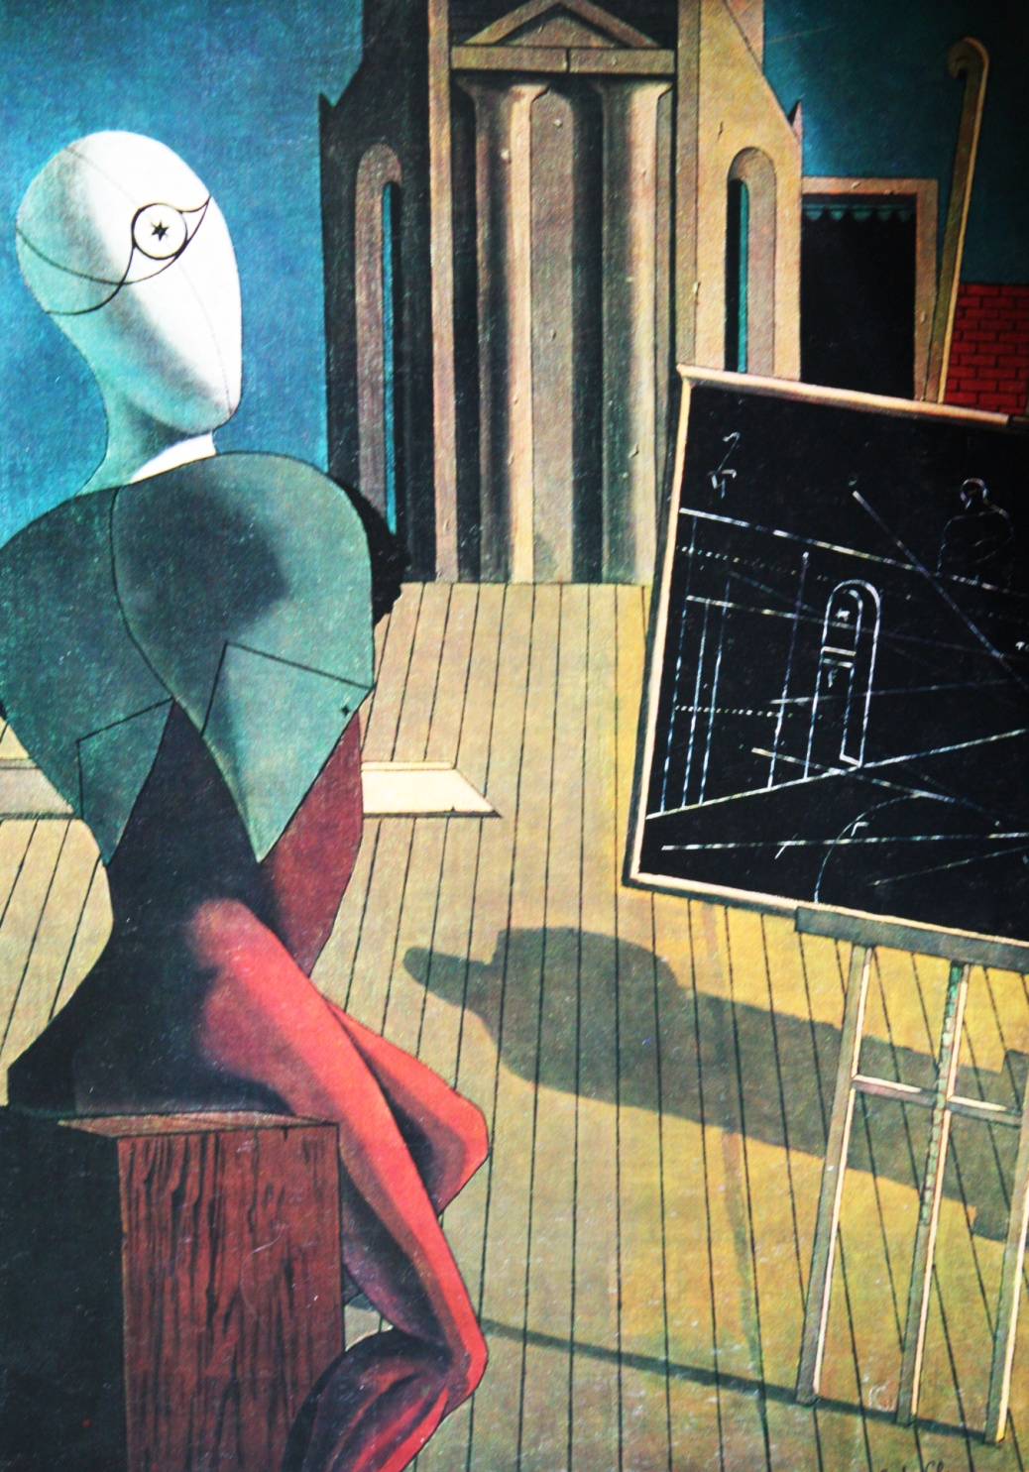
André Breton
André Breton studied Freudian therapeutic techniques which he used on soldiers in hopes that they would better deal with their trauma.
His true interest however lay in poetry and the arts.
The Seer (1915) Georgio de Chirico
Oil on Canvas

Slide 5
“Surrealism is not a style. It is the cry of a mind turning back on itself.”
Antonin Artaud

Slide 6
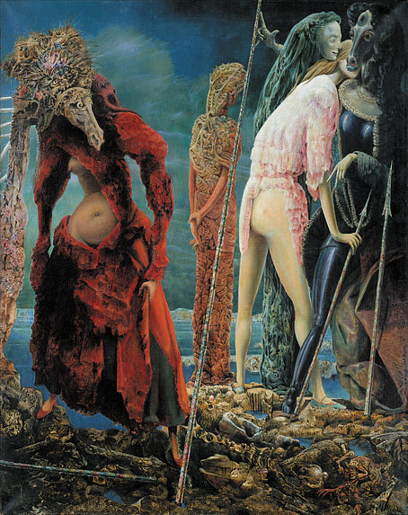
“Surrealism sought communication with the irrational and illogical, deliberately disorienting and reorienting the conscious, by means of the unconscious.”
The Anti-Pope (1942) Max Ernst
Oil on Canvas

Slide 7
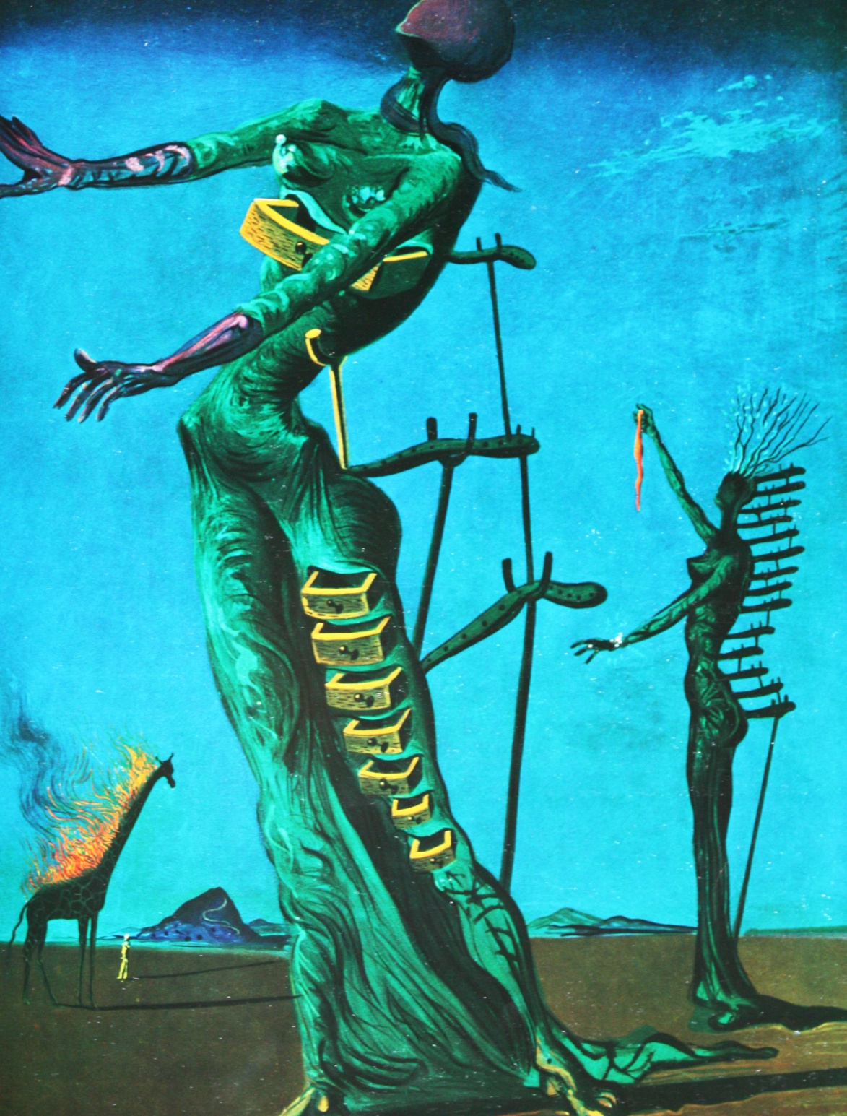
The art world had been forever changed by the visions bequeathed from the omnipotence of the dream world.
Giraffe on Fire (1937) Salvador Dalí
Oil on Canvas

Slide 8
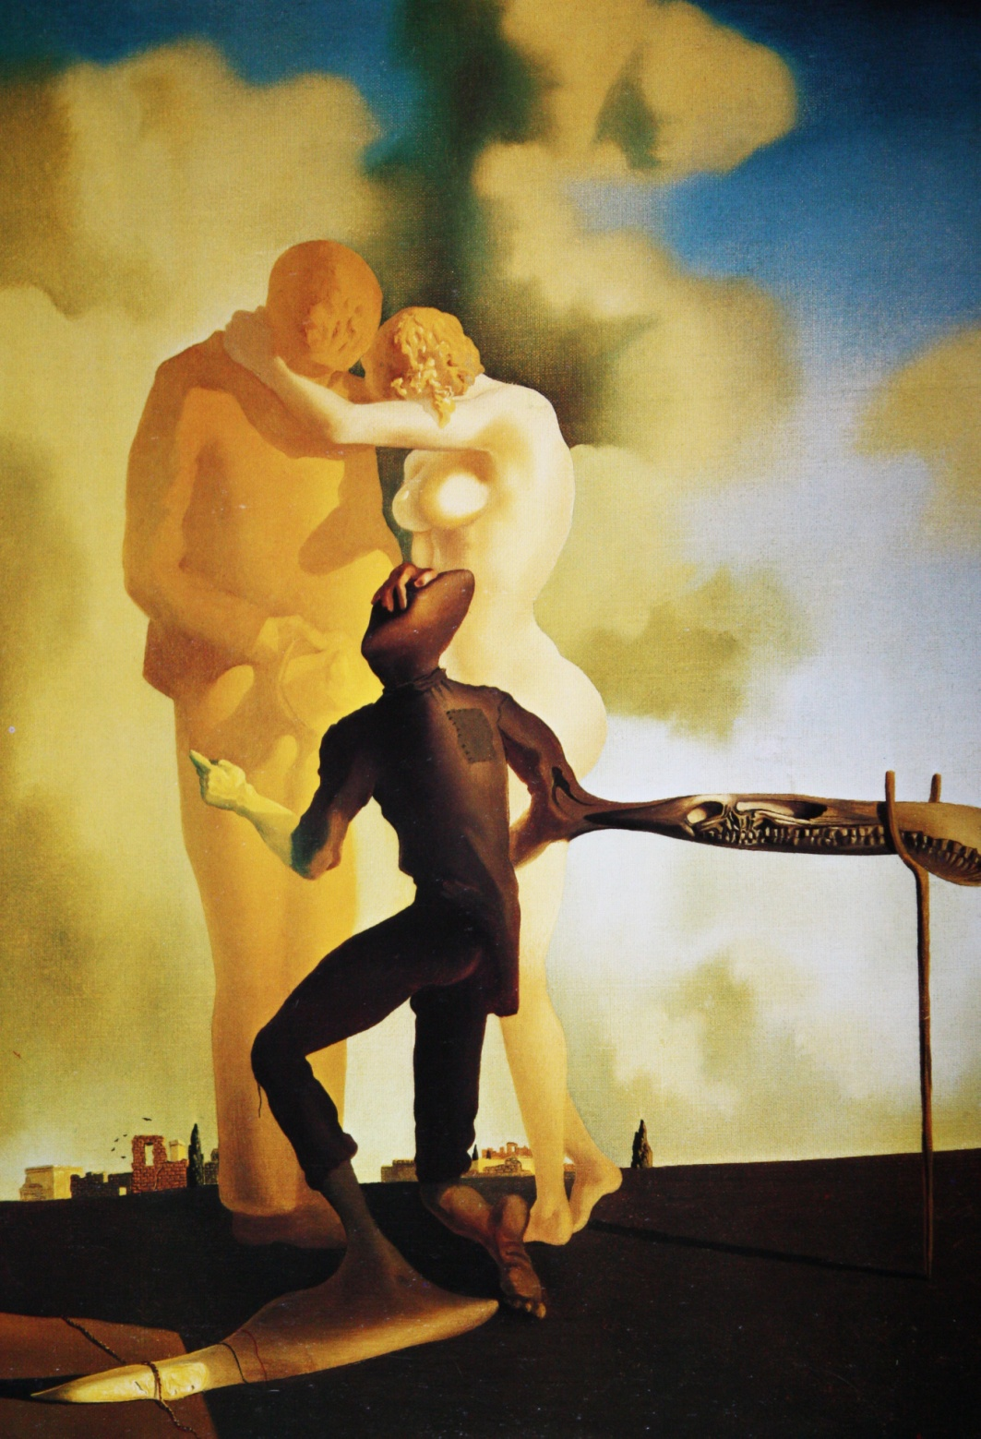
Jean Martin-Charcot and
Sigmund Freud
Jean Martin-Charcot was Sigmund Freud’s teacher, and had a great deal of influence over Freud, and the course of study he undertook regarding the study of the human mind.
Meditation on the Harp (1932-1934)
Salvador Dalí
Oil on Canvas

Slide 9
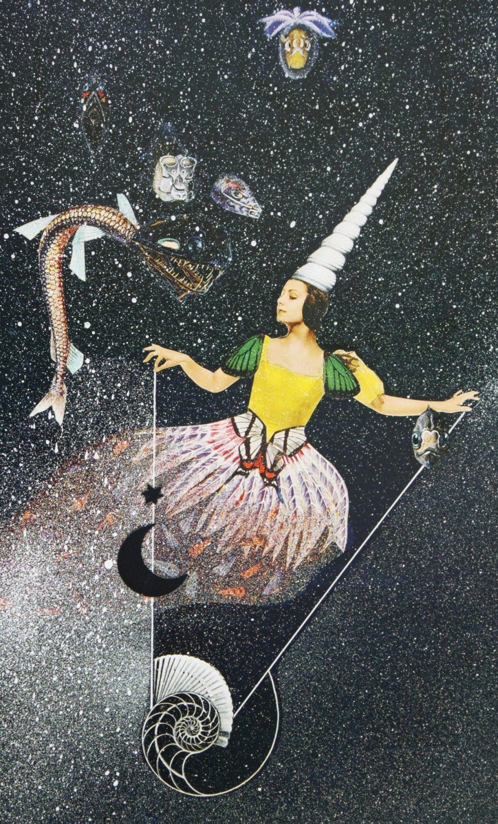
Freud practiced self analysis, and over time became overwhelmed with the “power of the imaginary and the sway of pictures that came to dominate” his conscious thoughts.
Untitled (Tamara Toumanova), (1940)
Joseph Cornell
Mixed Media Collage

Slide 10
The mind which plunges into Surrealism, relives with burning excitement the best part of childhood.
ANDRE BRETON, Surrealist Manifesto, 1924

Slide 11
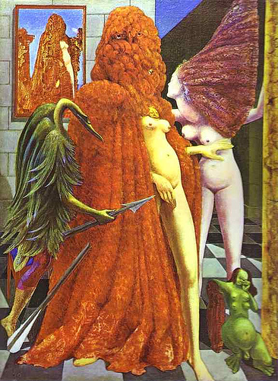
“Dreams provide a continuous, symbolic commentary in our internal psychological (and sometimes physical) functions whenever language fails to convey a particular inner experience, dream imagery can capture it vividly and authentically…”
The Robing of the Bride (1940)
Max Ernst Oil on Canvas

Slide 12
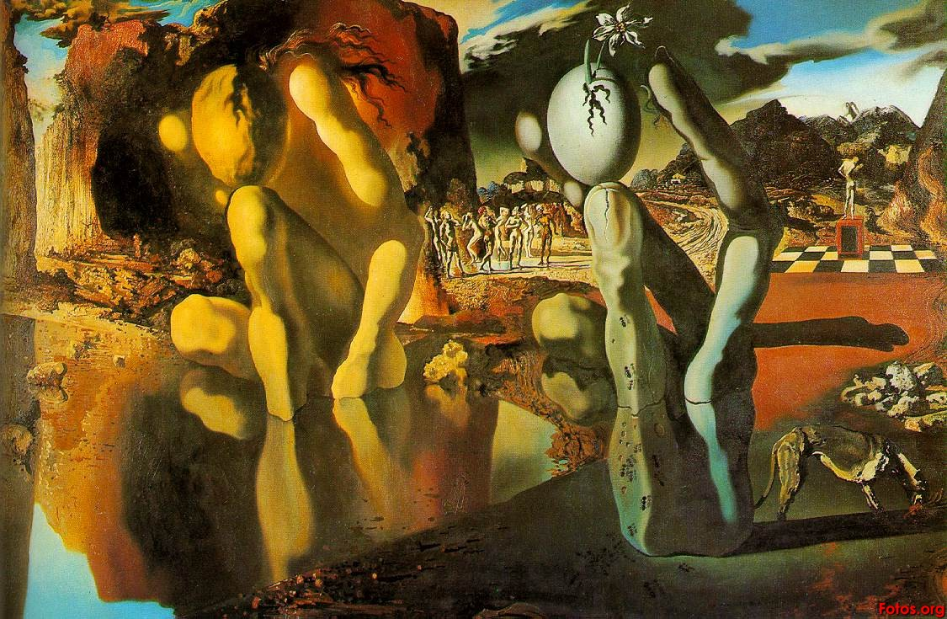
Metamorphosis of Narcissus (1936-1937) Salvador Dalí Oil on Canvas

Slide 13
“Conceptualizing dream imagery as a metaphorical narrative is analogous to understanding the underlying meaning of an abstract painting.”
Myron L. Gluckman M.D.

Slide 14
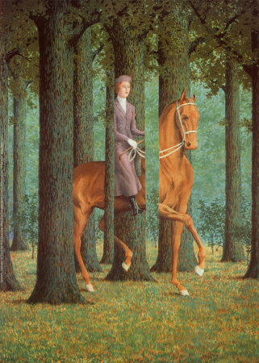
While we now have a better understanding of the inner workings of the unconscious mind, much of it is still speculation.
Carte Blanche (1965) René Magritte
Oil on Canvas

Slide 15
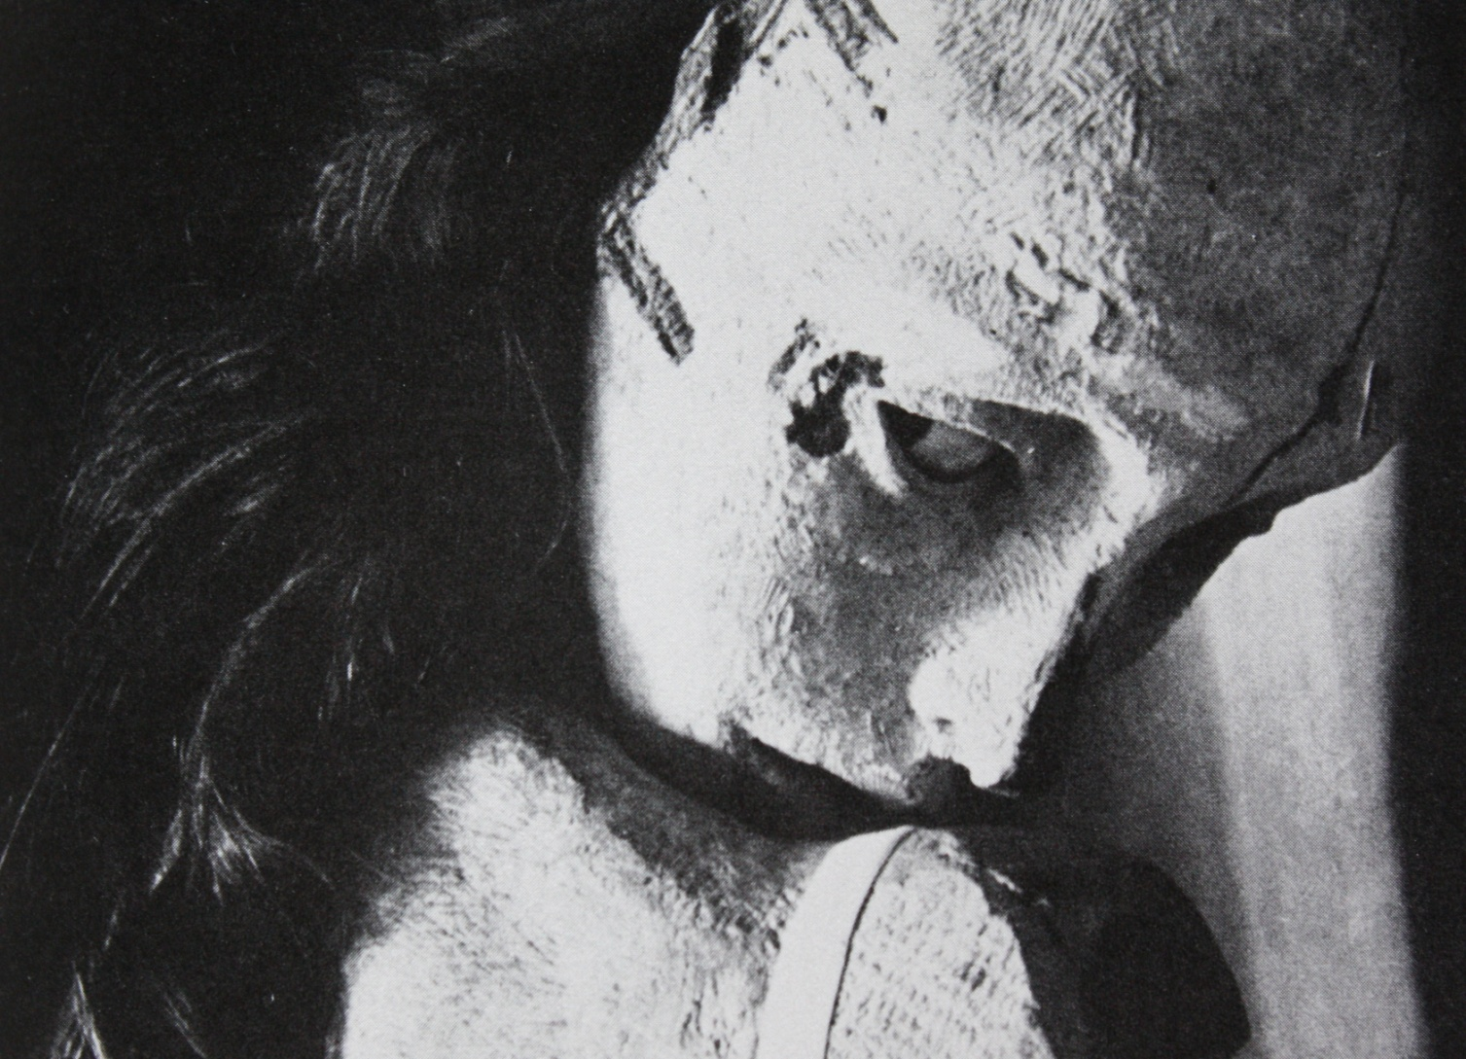
Doll (1934) Hans Bellmer
Mixed Media
Dreams can develop from feelings of anxiety that the dreamer may or may not be aware of.

Slide 16
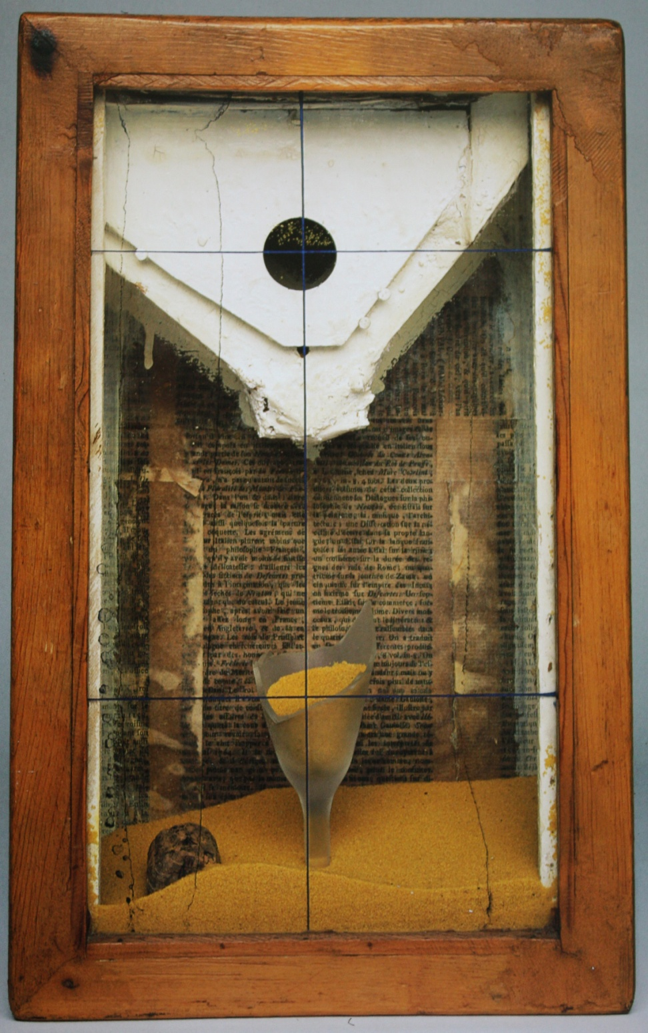
“We watch our dreams in the theater of the night.”
Sigmund Freud
Yellow Sand Fountain (1955) Joseph Cornell Mixed Media

Slide 17

Part of the Overwhelming (2009)
Danielle Feige Mixed Media

Slide 18
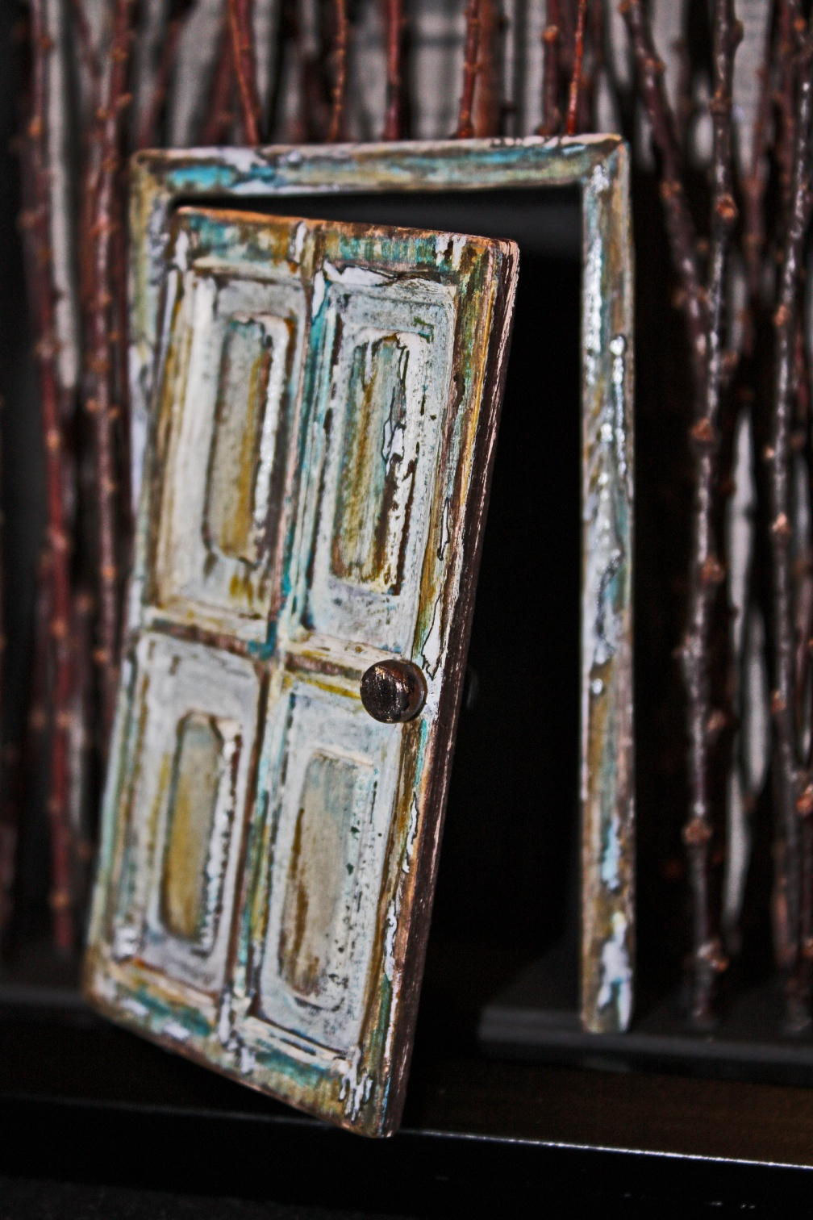
Close-up…
Part of the Overwhelming

Slide 19
Freud's influence can be felt the world over, even today. He sought inspiration from his teachers, and in return inspired others, not just in the world of psychotherapy, but also in the world of art.
The surrealist movement was not just a product of previous styles inflicted with the cultural up-lashing of the time, but rather a movement of self discovery.
By allowing the flow of ideas from the unconscious mind to the conscious, we have grown, and will continue to grow, for the betterment of ourselves, and for our art.
"The mind which plunges into Surrealism, relives with burning excitement the best part of childhood."
Andre Breton

Slide 20
fini

