Slide 1
The Principles of Art are basically rules or guidelines that
govern the way in which the Art Elements go together.
These include:
*EMPHASIS (Focal Point)
*HARMONY (Unity)
*BALANCE
*CONTRAST
*REPETITION
*RHYTHM
*MOVEMENT
Lets take a look at these individually…………….

Slide 2
Emphasis
EMPHASIS is used by an artist to make
an element or object stand out in a work
of art.
EMPHASIS is used by the artist to control
What part of the artwork the viewer sees
most or most often.
EMPHASIS is also used by the artist to
control how long a viewer spends looking
at each of the different parts.

Slide 3



Emphasis:
To make an element or object in a work of art stand
Out…..artists use emphasis.
Emphasis = Emphasis of size
Van Gogh
Emphasis = Emphasis of color
Salvador Dali
Emphasis of line
Grant Wood

Slide 4
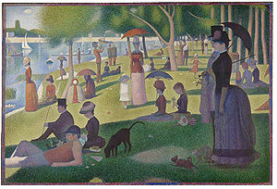
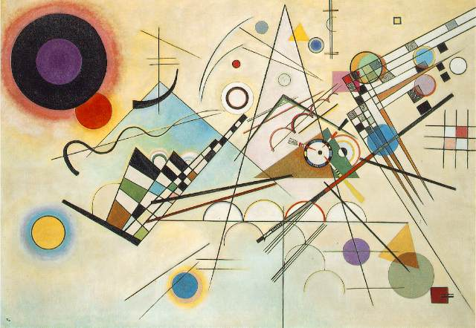
HARMONY
Harmony creates Unity by stressing the similarities
of separate but related parts.
Harmony emphasizes relationships in the artwork,
which encourages the eye to move throughout
the piece.
Kandinsky
George Seurat

Slide 5
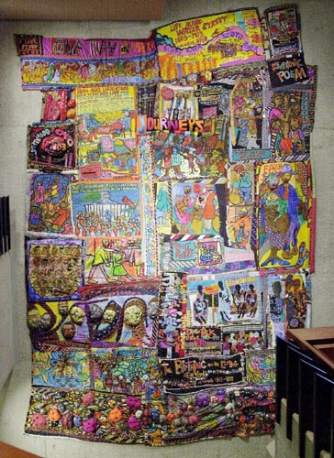
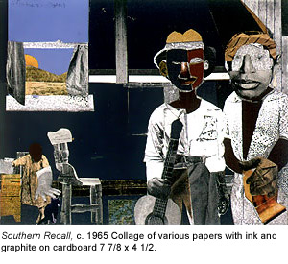
Harmony/Unity creates comfort for the viewer, allowing the eye to move through the art with ease, because of the use of similarities.
Non-Example
Example
Romare Bearden
Aminah Robinson

Slide 6
Balance
BALANCE in an artwork, it the
arrangement of art elements so that
no one part of a work overpowers, or
seems heavier than, any other part.
There are three basic types of balance. These are:
*Symmetrical or Formal Balance
*Asymmetrical or Informal Balance
*Radial Balance

Slide 7
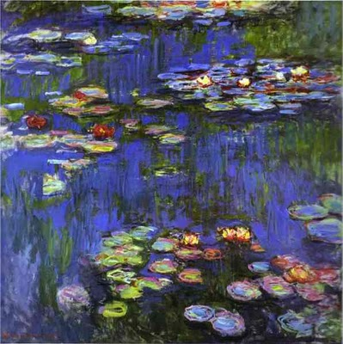
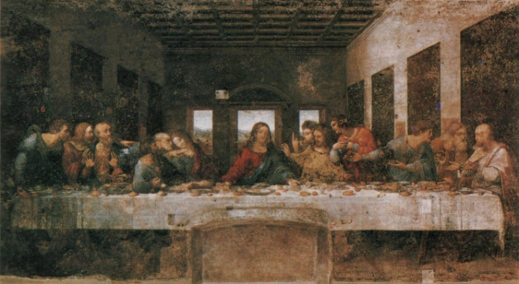
Symmetrical or Formal Balance is created when one
half of a work of art mirrors the other half..
Symmetrical or Formal Balance is predictable,
thus, sometimes less interesting.
Leonardo da Vinci
Claude Monet

Slide 8
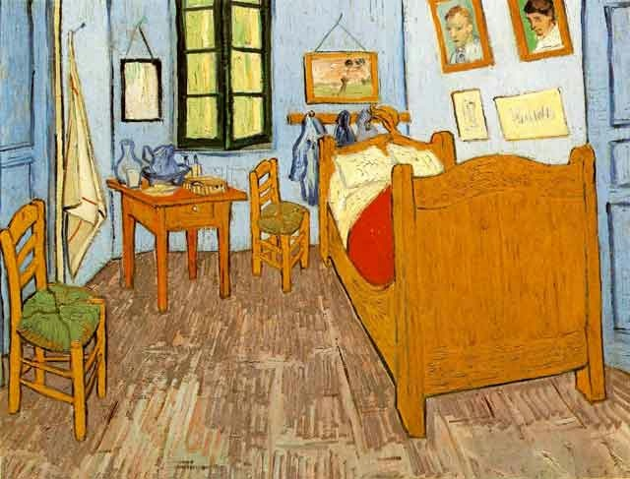
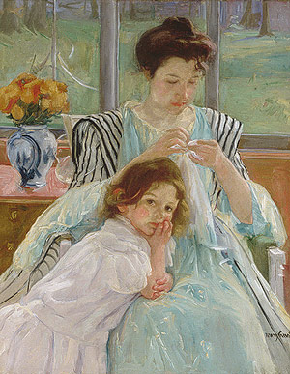
Asymmetrical or Informal Balance is evident when
two unlike objects appear to have equal weight. When used skillfully, it can create more interesting
compositions.
Vincent van Gogh
Mary Cassatt

Slide 9
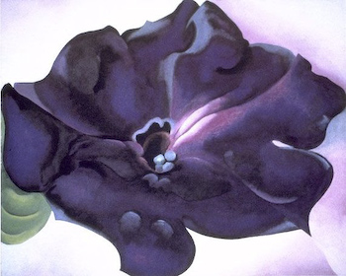
Radial Balance in an artwork occurs when the
elements or objects are positioned around a
central point.
Georgia O’Keefe

Slide 10
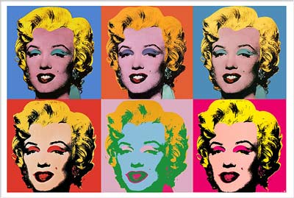
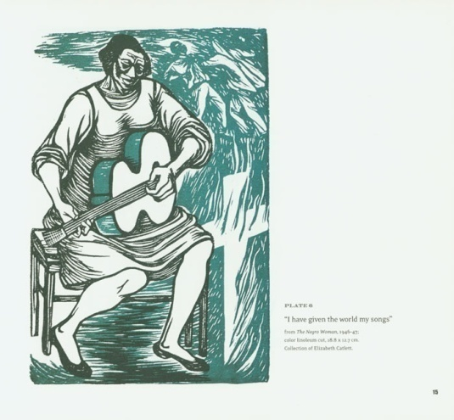
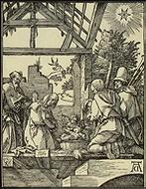
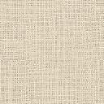
Contrast
CONTRAST in an artwork is created-when
the artist makes a difference in value,
color, texture, shape, line, form, or space.
Color Contrast
by Warhol
Value Contrast
by Durer
Texture Contrast
by Elizabeth Catlett

Slide 11
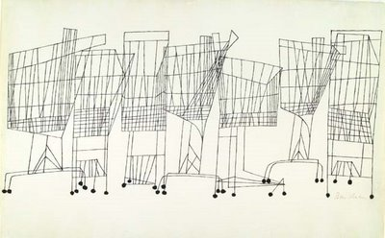
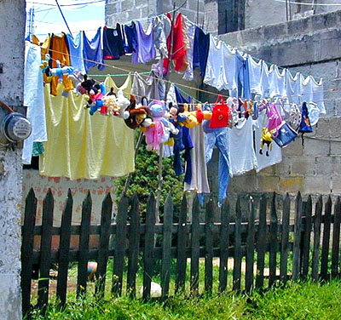
Pattern
Pattern / Repetition /Rhythm is the repeating
of shapes, lines, color, or other art
elements in planned or random order to create
interest or make the artwork more exciting.
Ben Shahn

Slide 12
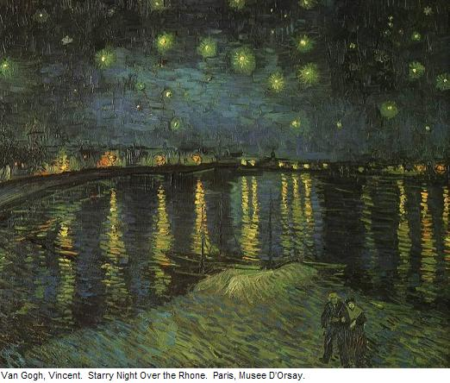
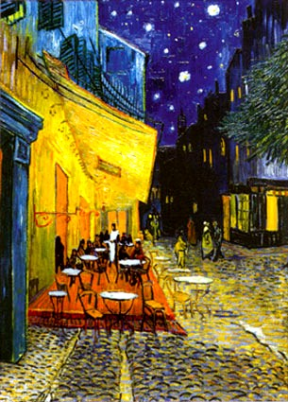
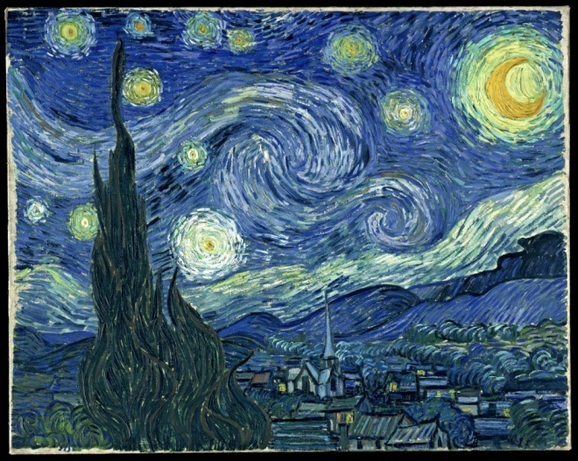
Movement
MOVEMENT in a work of art directs the viewer
through the art piece –often to the focal area.It
also encourages the viewer to sense action
within the work.
Van Gogh
Van Gogh
Van Gogh

