Slide 1
PRINCIPLES OF DESIGN
Directions or guidelines for using the elements of design

Slide 2

BALANCE
A sense of equilibrium.
  When establishing balance consider visual weight created by size, color, texture and number of objects.

Slide 3
TYPES OF BALANCE
SYMMETRICAL
  Achieved by placing identical objects on either side of a central point.
ASYMMETRICAL
  Achieved by placing different objects of equal visual weight on either side of a central point.

Slide 4
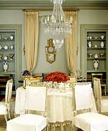
SYMMETRICAL BALANCE
Creates a quiet, restful feeling.
Suggests restraint, orderliness, formality.
Also called, FORMAL balance.

Slide 5
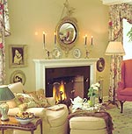
Symmetrical Balance
Identical candle sticks, plates, sit on the mantle at each side of the wall mounted mirror.

Slide 6
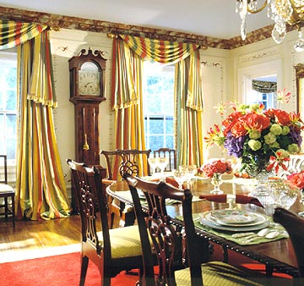
Symmetrical Balance
Windows draped in identical fabrics, flank both sides of the grandfather clock.

Slide 7
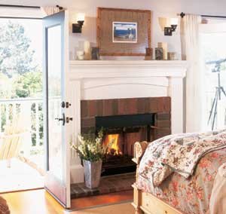
Symmetrical Balance
Identical light sconces are placed on both sides of framed picture.

Slide 8
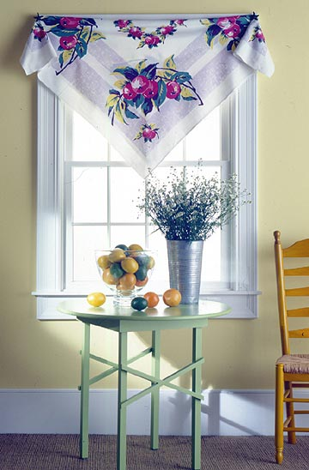
Asymmetrical Balance
Creates more interesting arrangements.
Suggests informality, relaxed.
Also referred to as INFORMAL balance.

Slide 9
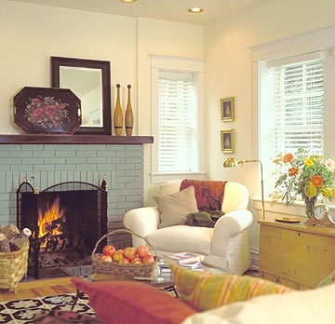
Asymmetrical Balance
Mirror is placed off center on the mantle.
Tray and bottles on either side of the mirror help to balance it out.

Slide 10
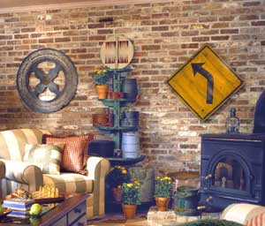
Asymmetrical Balance
Wall hangings of the same visual weight are hung on each side of the plant stand.
Chair balances out the fireplace on the other side of the room.

Slide 11
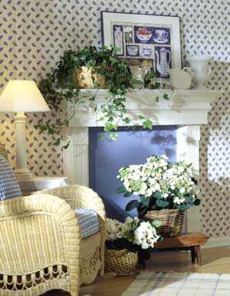
Asymmetrical Balance
Items on the mantle are arranged using Asymmetrical Balance. The picture is slightly off center with large plant on the left is balanced by a group of vases on the right.

Slide 12
Radial Balance
Radial Balance involves having furnishings or patterns arranged in a circular manner.
Radiation creates a sweeping, dramatic, circular motion in a room.

Slide 13
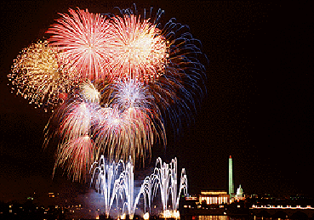
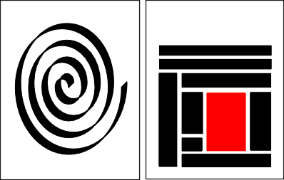
Radial Balance

Slide 14

RHYTHM
Leads the eye from one point to another, creates motion.

Slide 15
TYPES OF RHYTHM
Rhythm by Repetition
Rhythm by Gradation
Rhythm by Radiation
Rhythm by Opposition
Rhythm by Transition

Slide 16
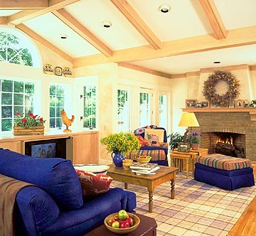
Rhythm By Repetition
Rhythm created by duplicating (repeating) shapes, colors, pattern, line, texture.
Beams in the ceiling are repeated. Window panes, repeat. Stripes on ottoman and chair are repeated.

Slide 17
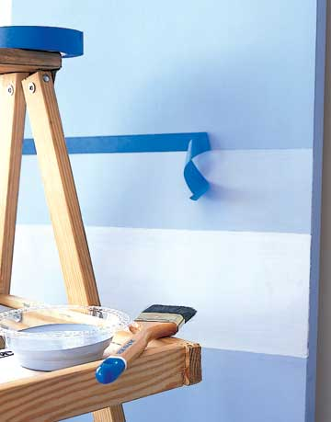
Rhythm By Gradation
Rhythm created by a gradual change in size or color.
Paint on wall changes gradually in value.

Slide 18
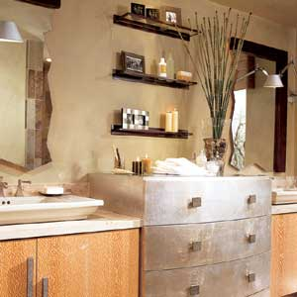
Rhythm By Radiation
Rhythm created by identical objects coming from a central axis.
Tall Grasses “radiate” from the center of the vase on this bathroom vanity.

Slide 19
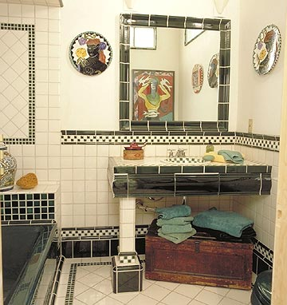
Rhythm By Opposition
Rhythm created by lines at right angles or contrasting colors.
Contrasting black and white tiles and the lines intersecting at right angles.

Slide 20
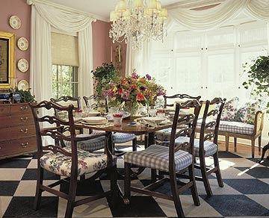
Rhythm By Transition
Rhythm created by curved lines that carry your eye across a straight surface.
Window treatments that gently swag down, create a soft rhythm by transition.

Slide 21
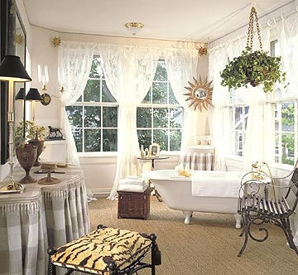
What Type of Rhythm?
Repetition?
Gradation?
Radiation?
Opposition?
Transition?

Slide 22
SCALE & PROPORTION
Scale relates to the size of a design in relation to the height and width of the area in which it is placed.
Proportion relates to the parts of the object and how one part relates to another.

Slide 23
SCALE
Relates to the actual and relative size and visual weight of the design and its components.
Furniture and accessories must be in scale to the room

Slide 24
PROPORTION
The Golden Mean – the division of a line or form so that the smaller portion has the same ratio to the larger as the larger has to the whole.
Effective Ratios are 2:3, 3:5, 5:8, 4:7, etc.
Square is the least pleasing shape.
Rectangles are more pleasing, especially with a ratio of 2:3.

Slide 25
PROPORTION
The creative use of color, texture, pattern, and furniture arrangement can create illusions of properly proportioned space.

Slide 26
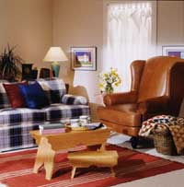
SCALE & PROPORTION
Too Big, Too Small, Just Right
This chairs massive scale diminishes everything around it.

Slide 27
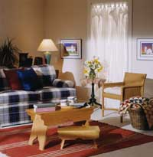
Too Small.
The chairs light palate accentuates its skinny scale.

Slide 28
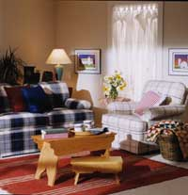
Just Right.
This club chair matches the scale of the sofa.

Slide 29
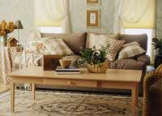
Too Big.
Coffee table is over-scaled for the sofa.

Slide 30
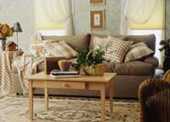
Too Small.
Table not only looks out of proportion, it functions poorly as well.

Slide 31
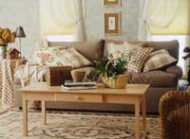
Just Right.
The table is substantial enough to anchor the furniture grouping, yet it leaves room for traffic flow around both ends.

Slide 32
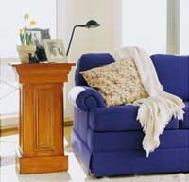
Too Tall.
Used as an end table, this wood pedestal towers over the sofa, making the sofa appear small and the pairing awkward.

Slide 33
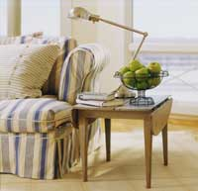
Too Short.
The lamp would need to be fully stretched to offer good illumination from this low point.

Slide 34
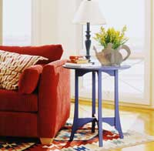
Just Right.
The perfect pairing, visually and physically, is a tabletop that is a couple of inches shorter than the sofa arm.

Slide 35
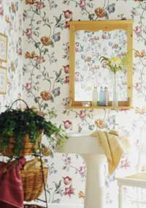
Too Big.
The large-scale motif and strong colors of this floral wallpaper overpower the petite powder room as well as the fixtures and furniture in it.

Slide 36
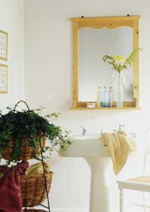
Too Small.
The pattern is so small and pale that it almost disappears.

Slide 37
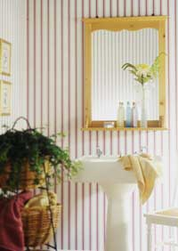
Just Right.
The narrow contrasting stripes provide the ideal balance for the clean-lined pedestal sink and oversize pine mirror.

Slide 38
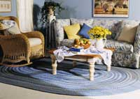
Too Big.
This rug covers too much of the floor beyond the conversation area to define it as a discrete space.

Slide 39
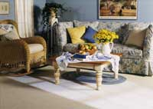
Too Small.
Instead of creating intimacy, the rug only increases the appearance of isolation.

Slide 40
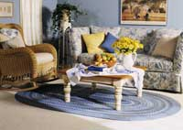
Just Right.
Choose an area rug that’s about as long and wide as the furnishings in the space.

Slide 41
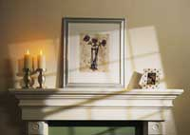
Too Little.
Too much space between objects makes the candlesticks and the too-small frame look lonely, the bare wall yawning above.

Slide 42
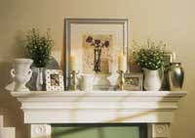
Too Much.
There’s no time to pause to consider any single object, since they are all stepping on one another’s toes in a jostle for space.

Slide 43
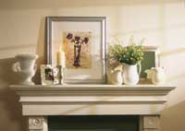
Just Right.
The weight now shifted to the left side, fewer items are needed there for balance.

Slide 44
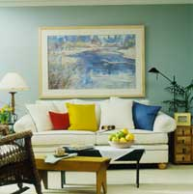
Too Big.
There’s no breathing room in this are-to-sofa match.

Slide 45
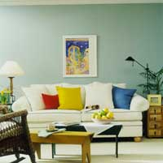
Too Little.
This picture is tall enough, roughly matching the height of the sofa. But it ends up looking leggy and lost because it’s too skinny in proportion to the sofa’s width.

Slide 46
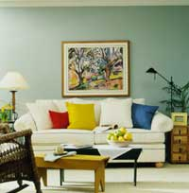
Just Right.
To size a single picture, choose one that’s nearly the same height as the sofa and between half and two-thirds its width.

Slide 47
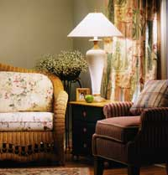
Too Big.
This tall lamp towers above the nearby sofa and chair. It is also several inches taller than the table it rests on, throwing the balance off there as well.

Slide 48
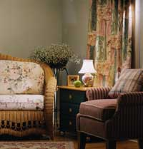
Too Small.
This lamp is overwhelmed by the high-back sofa and stocky chair that surround it.

Slide 49
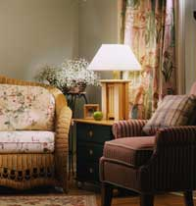
Just Right.
For the best fit, an end-table lamp should be tall enough to clear the top of the sofa with a little room to spare, yet not so tall that it dwarfs the table it rests on.

Slide 50
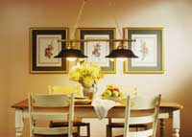
Too Big.
This 5-foot-wide double pendant chandelier overpowers the table.

Slide 51
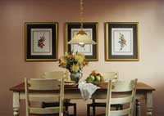
Too Small.
The fixture is too small to adequately light the table.

Slide 52
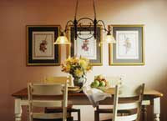
Just Right.
In general, a chandelier’s width or diameter should be at least 2 feet narrower than the table length.

Slide 53
Proportion/Scale
As a group, make a room that is OUT of proportion/scale.
Any type of room will work.
The more OUT of proportion the better!
Must use a minimum of 15 items.

Slide 54
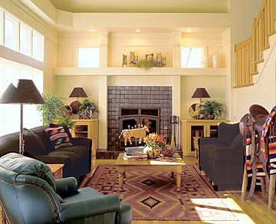
EMPHASIS
The center or focus of attention and interest within a design
  The feature that commands attention and makes a design visually interesting.

Slide 55
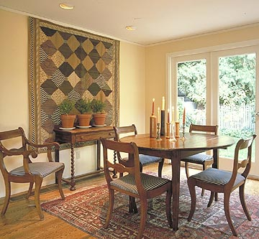
Emphasis
Architectural features such as fireplaces or decorative windows are often used as focal points.
Works of art and decorative accessories are often emphasized in a design.

Slide 56
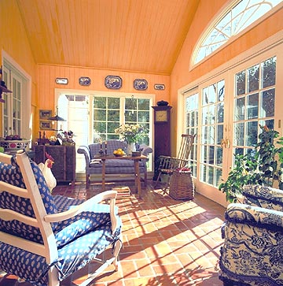
WAYS TO CREATE EMPHASIS
Arrangement of furniture around a focal point.
Use of color, texture, or pattern.
Placement of accessories.
Use of lighting.

Slide 57
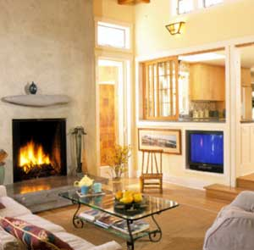
Guidelines for Creating Emphasis
The point of emphasis should command attention, but not dominate the overall design.
Other features within the room should not compete for the emphasis.

Slide 58
Harmony
There are 2 types of harmony.
  Unity
  Variety

Slide 59
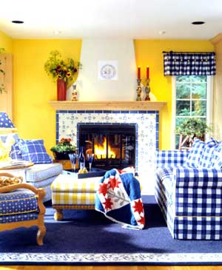
UNITY
Unity occurs when all the parts of a home or room are related by one idea.
A unified design has consistency of style

Slide 60
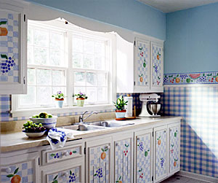
VARIETY
When two or more different elements of design are used to add interest to a design.
Variety can be achieved by combining different styles and materials, as long as they are compatible.

Slide 61
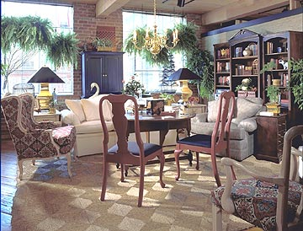
HARMONY
Is achieved when unity and variety are effectively combined.
  Carrying variety too far creates confusion.
  A lack of unity may make a small home seem even smaller.

Slide 62

Carriage Bed

Slide 63


Lighthouse

Slide 64


Slide 65


Slide 66


Jungle Safari

Slide 67


Slide 68


Hayloft

Slide 69


Slide 70



Mammoth Ice Caves

Slide 71


Sports Den

Slide 72



Slide 73



Log Cabin

Slide 74



Arabian Nights

Slide 75
QUESTION?
What are the elements of design?
  List Them (7)
What are the principles of design?
  List Them (5)

